Slide 1
About me:
Name:S.yogalakshmi
Course:b.sc(computer science)
Collage name:valliammai women’s college of arts and science
Email ID: lokesh 972007@gmail.com
Phone number:9361369586

Slide 2
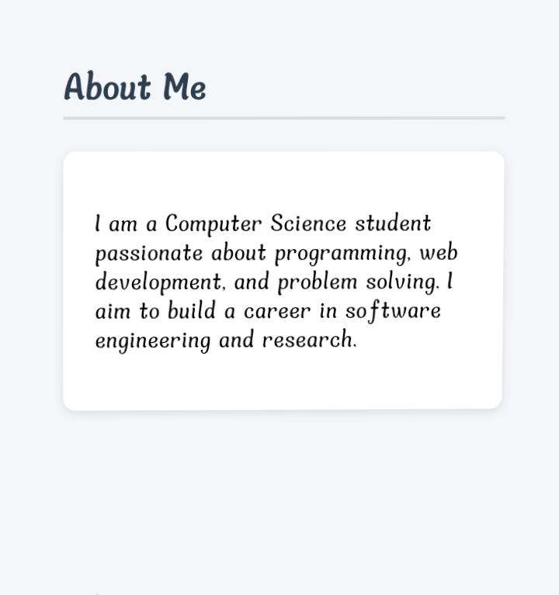
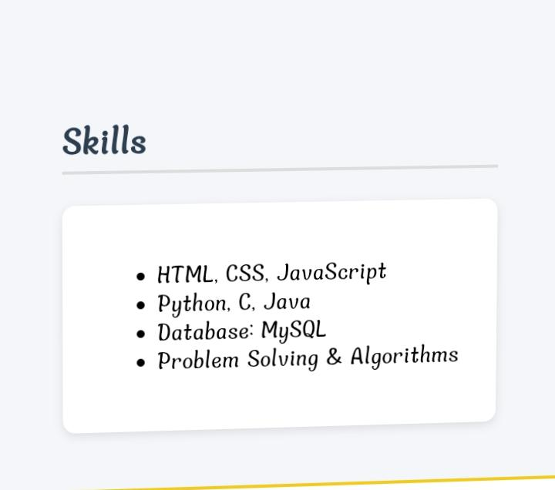
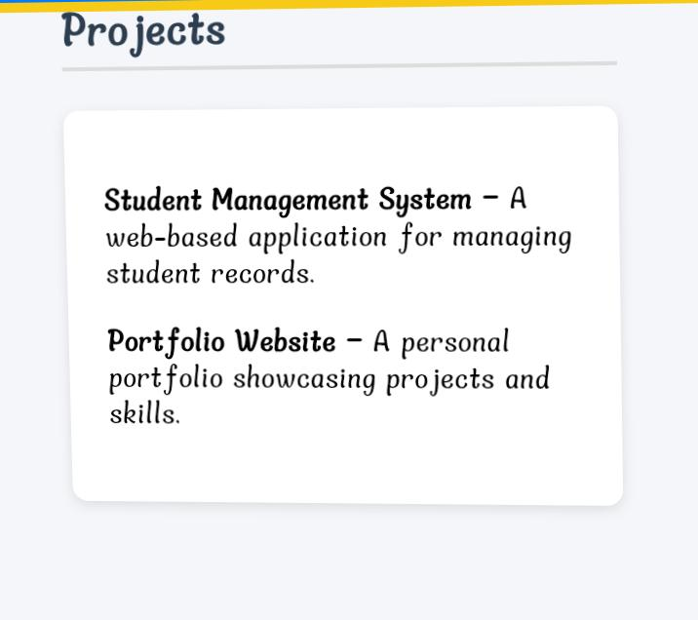
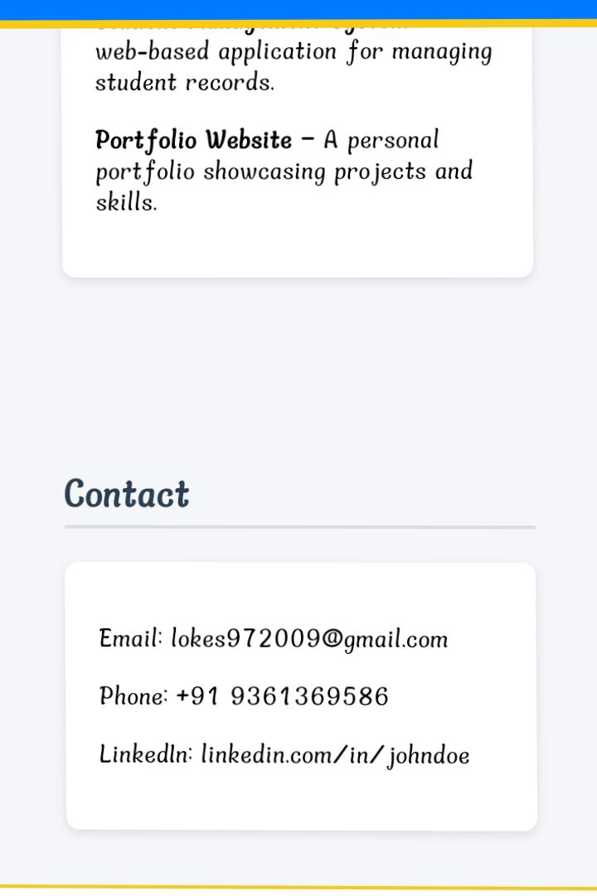
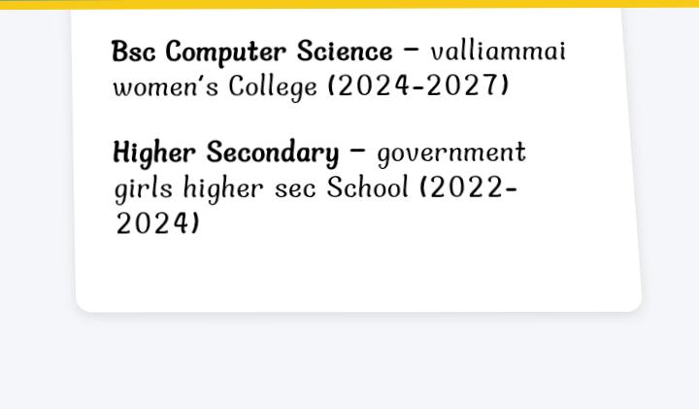

Slide 3
Table contents:
Myself
Academic information
Skills
Projects
Achievements
Extracurricular activities
Intership experience
Personal details
Conclusion

Slide 4
Myself:
My name is yogalashmi.s,a second year computer science student with a passion,wep development and problem solving.i believing in continuous learning of programming.

Slide 5
Academic information:
B.Sc computer science (2024-2027)valliammai women’s college 68%
Higher secondary (2022-2024)GHS school sclc(2021-2022)GHS school

Slide 6
Skill:
Programming language:c++, python
Web development:HTML,CSS
Communication and presentation
Time management.

Slide 7
Extracurricular Activities:
Creative: drawing, writing
Sports: hockey,kho kho

Slide 8
Personal details:
Data of birth:13/9/2007
Language:Tamil, english
Hobbies: drawing, cooking

Slide 9
Git hub
Github link:https://github.com/yoga1392007

Slide 10
Conclusion:
I am an enthusiastic learnes with strong technical and communication skills.
I am confident that my skills, projects and dedication with confident and achieve my goal.

